Slide 1

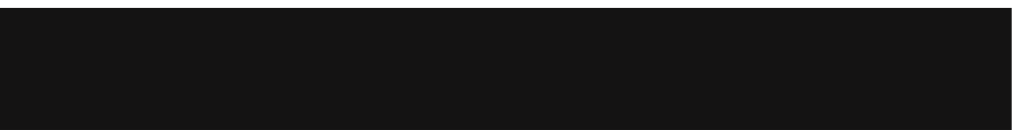
PORTFOLIO
2025
LEGROS BRYAN
FREELANCE TRANSLATOR

Slide 2
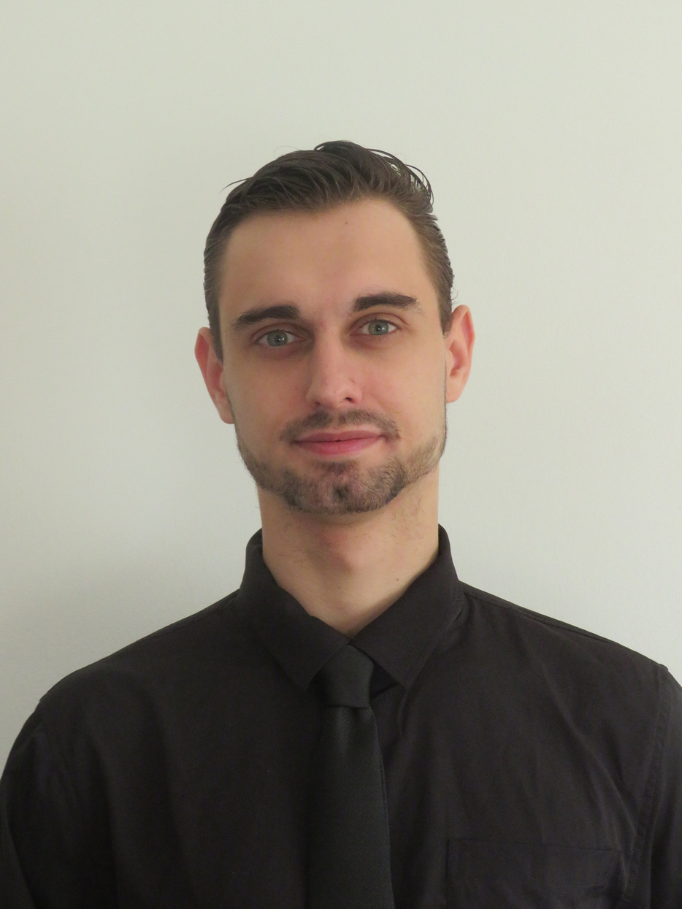


My Profile
lMy name is Bryan Legros, a freelance translator passionate about languages, communication, and international marketing. With a degree in Applied Foreign Languages, I have gained solid experience in marketing and economic translation, particularly during my two years at Teleperformance Portugal in Lisbon.
Rigorous, curious, and results-driven, I am committed to delivering faithful, natural, and perfectly adapted translations for each target audience.
My Experience
FREELANCE TRANSLATOR
Upwork
01/2024 - 05/2025
META/TIKTOK TRANSLATOR
01/2022 - 01/2024
Téléperformance Portugal - Lisbon
SALESPERSON
06/2021 - 12/2021
Subway - Saran
LEGROS Bryan
https://www.linkedin.com/me?trk=p_mwlite_feed-secondary_nav
@bryan_ls_

Slide 3

EDUCATION
Bachelor’s Degree in Applied Foreign Languages
I obtained a Bachelor's degree in Applied Foreign Languages with a specialization in English, Spanish, and Chinese.
This program allowed me to deepen my knowledge of English and Spanish, and to learn a new language—Chinese—both in speaking and writing.
I also had the opportunity to discover the cultures of English-speaking, Spanish-speaking, and Chinese-speaking countries.
However, studying the British and French press was especially valuable for the work I do today.
It helped me acquire essential skills such as negotiation, article writing, and contacting people to gather information.
Thanks to my studies, I am multilingual and can make myself understood almost anywhere in the world, which is a real asset today.
FRANÇOIS RABELAIS UNIVERSITY OF TOURS
2018 - 2021

Slide 4

TRANSLATOR
Company
: Téléperformance Portugal
Year
: 2022 - 2024
For two years, I worked at Teleperformance Portugal in Lisbon as a multilingual translator. This experience allowed me to grow in a demanding international environment focused on linguistic quality and understanding of digital platforms.
My main role was to translate and localize issue reports related to Facebook and TikTok, ensuring clarity in communications between users and technical support teams. I also contributed to the translation of advertising campaigns, making sure they were culturally and fluently adapted in four languages: French, English, Spanish, and Portuguese.
Thanks to this mission, I refined my skills in technical terminology, user-oriented writing, and marketing translation, while meeting the strict deadlines set by project teams and internal tools.

Slide 5
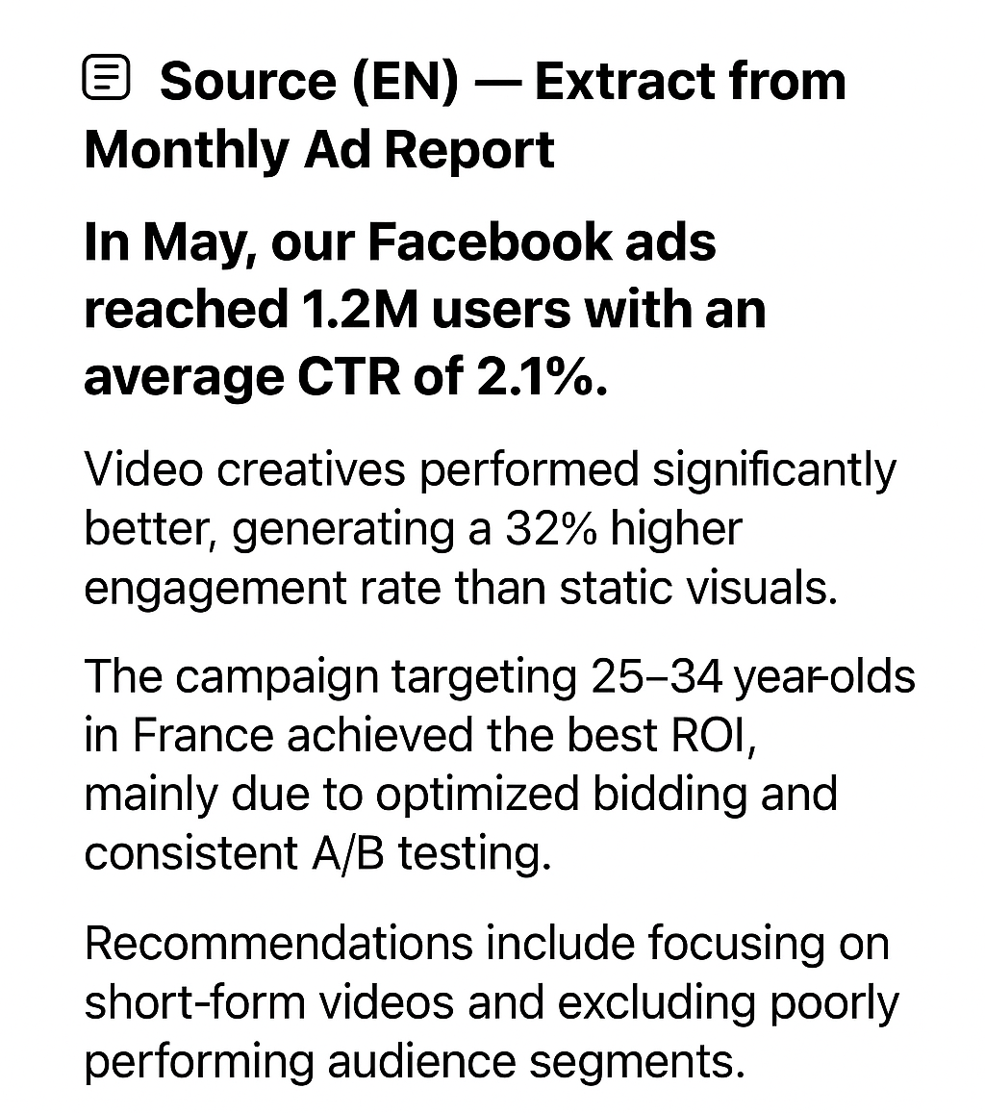
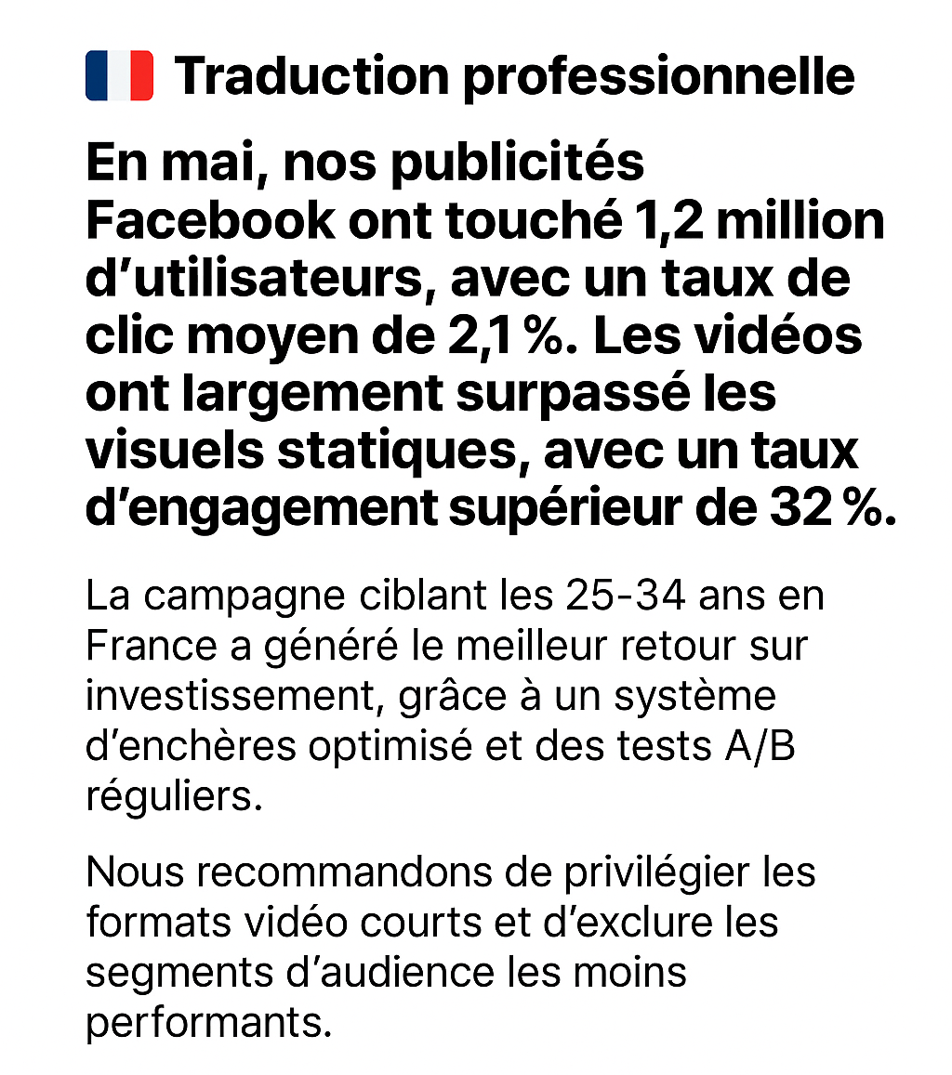

Slide 6
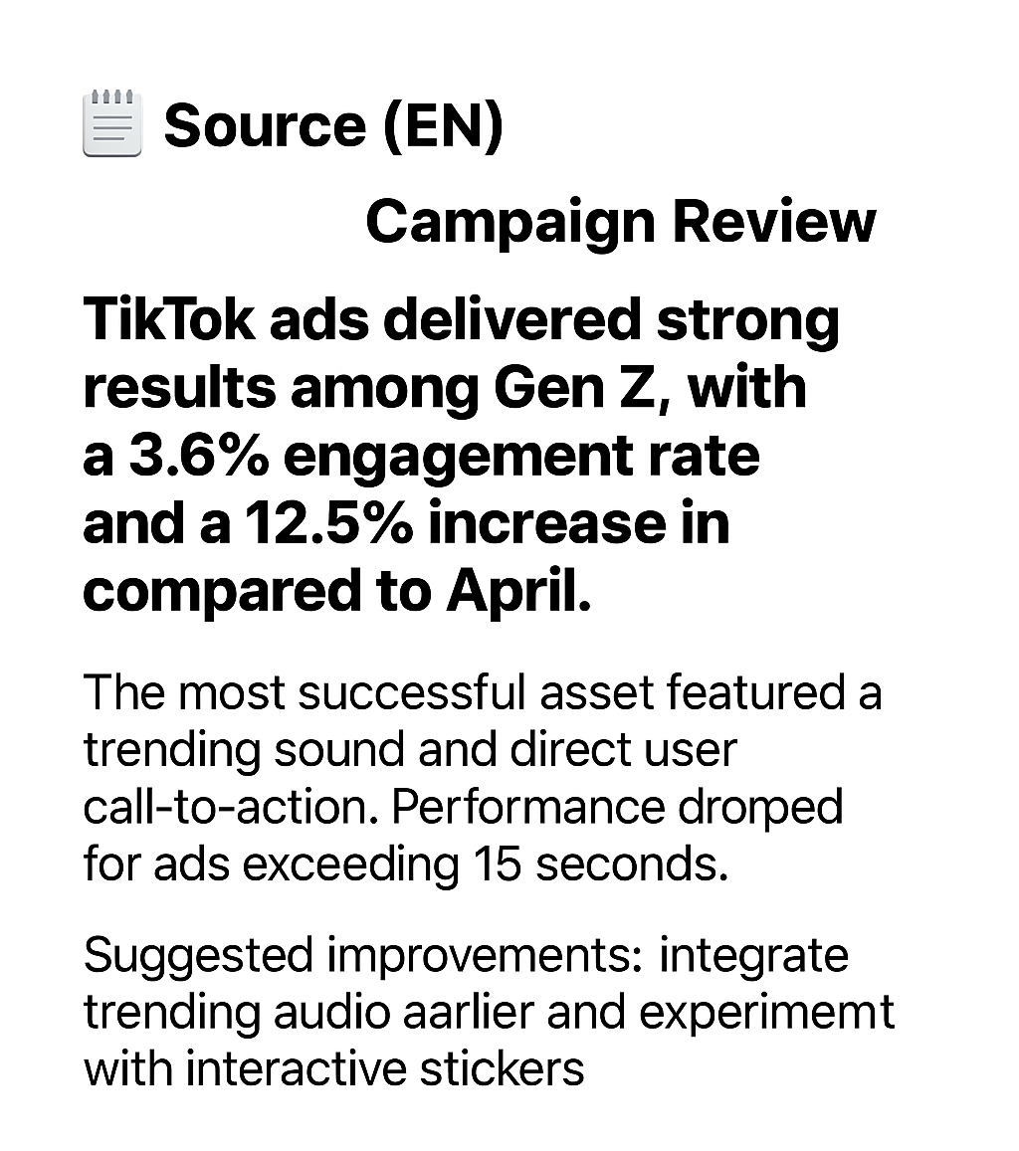
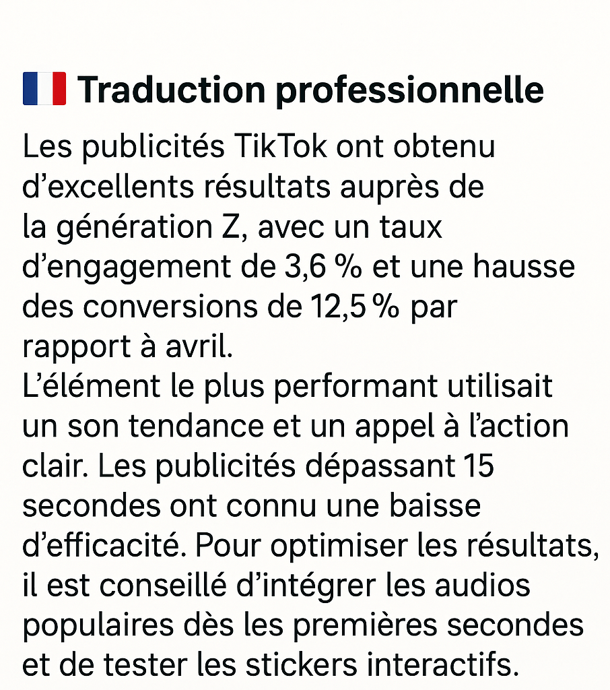

Slide 7
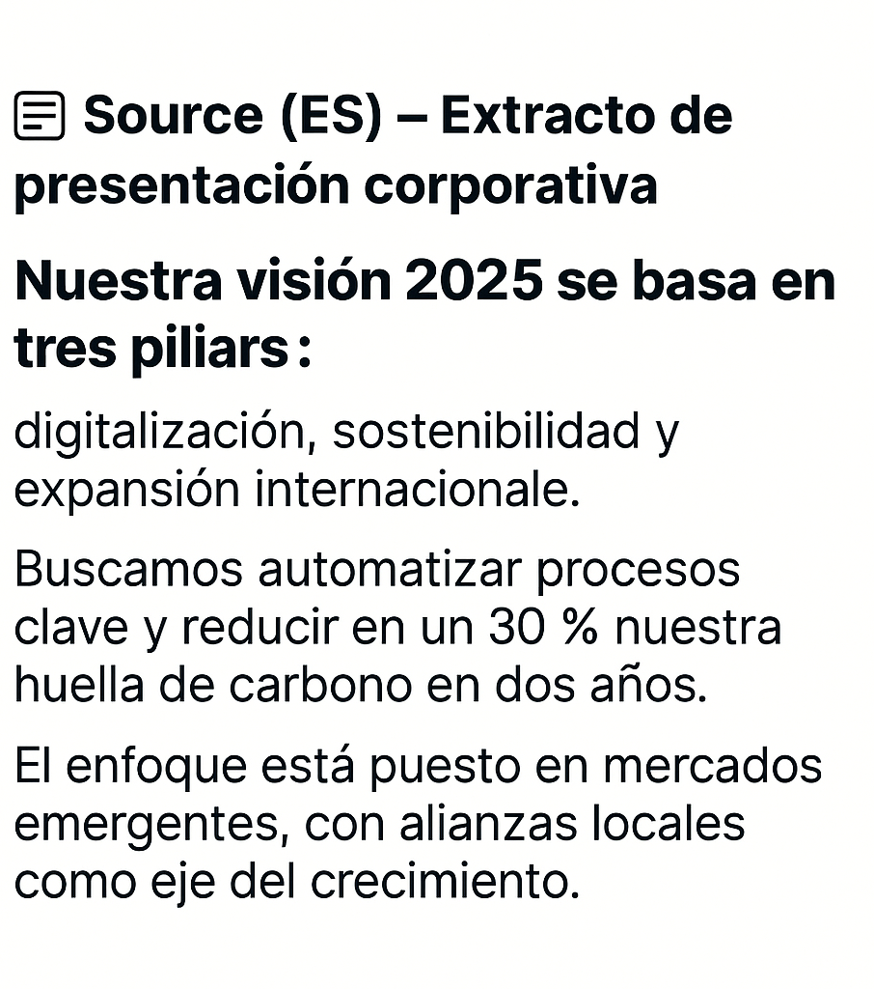
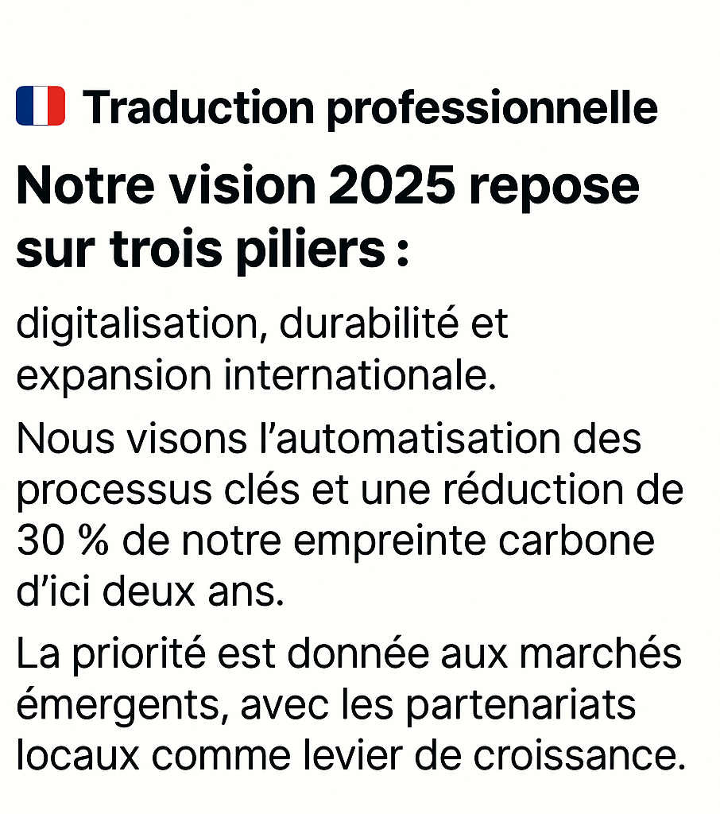

Slide 8
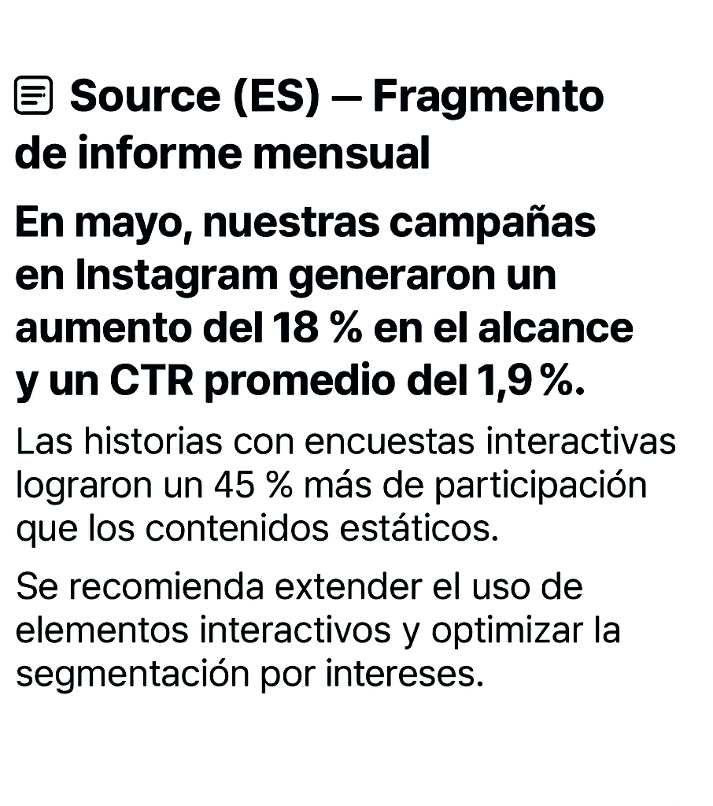
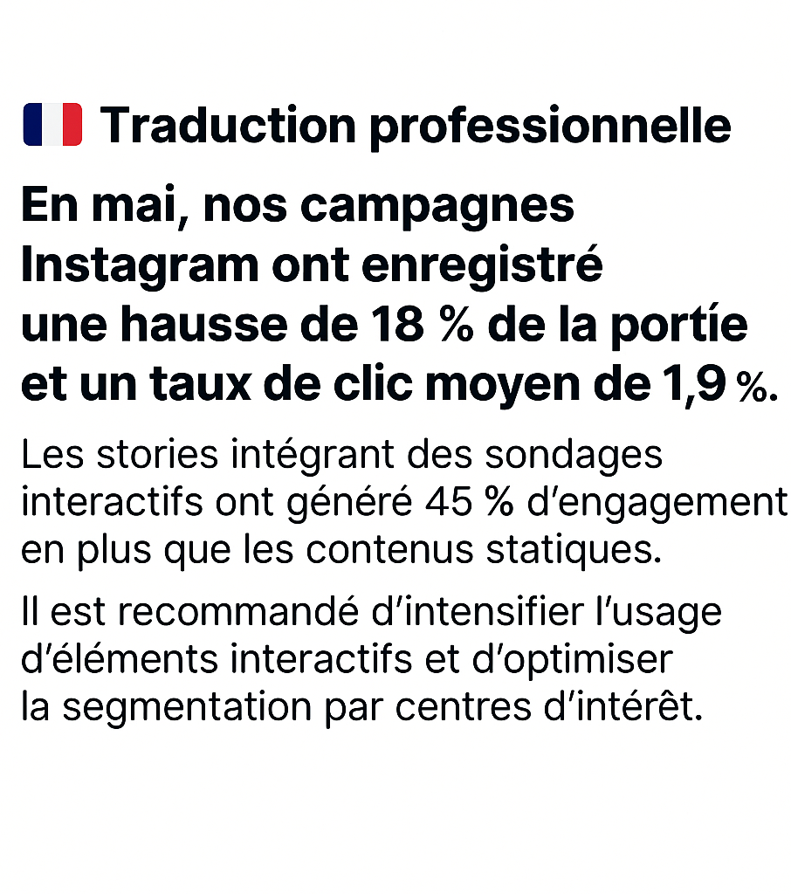

Slide 9
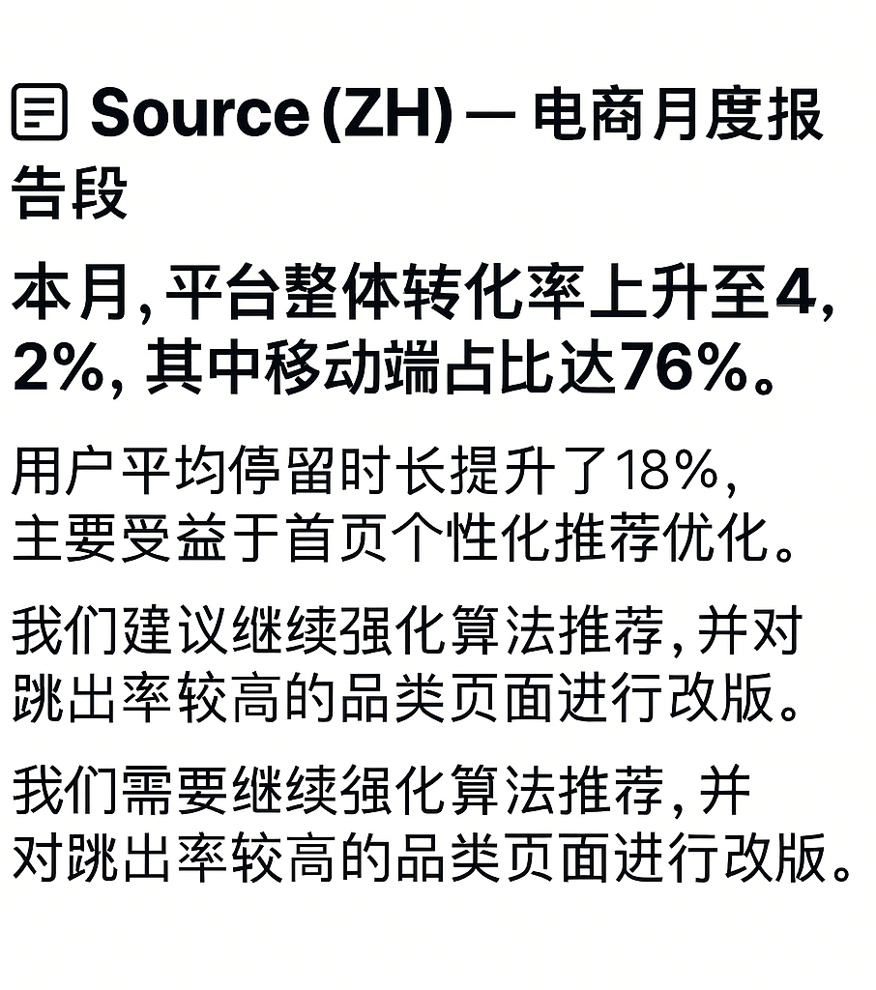
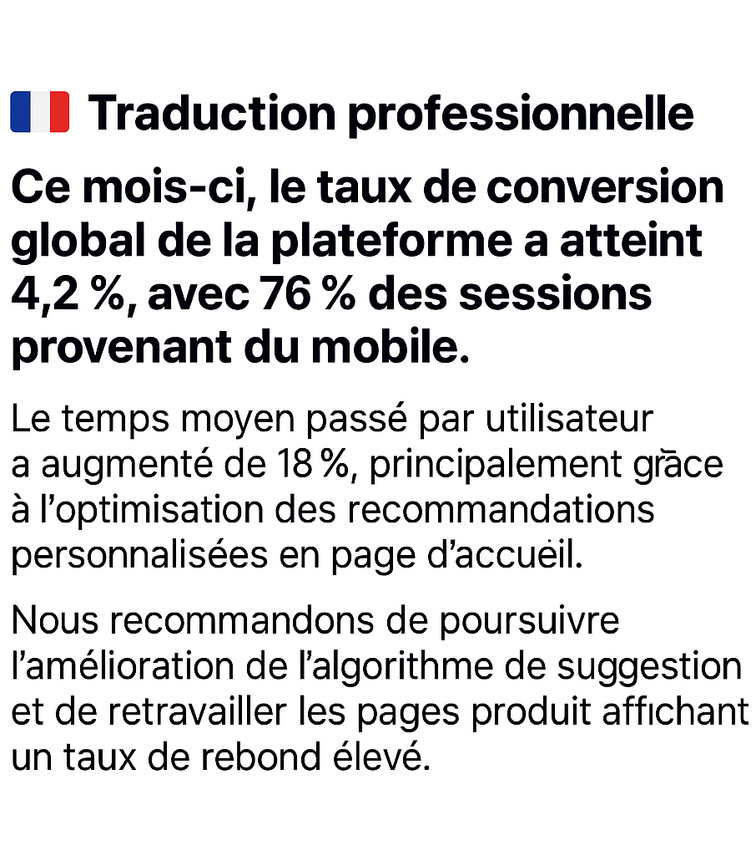

Slide 10
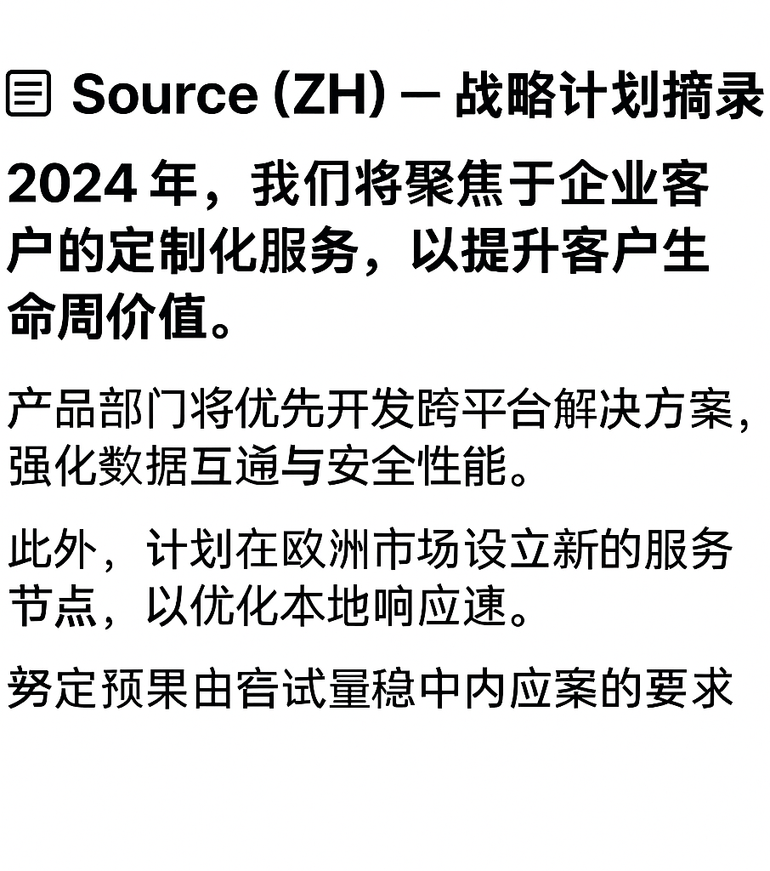
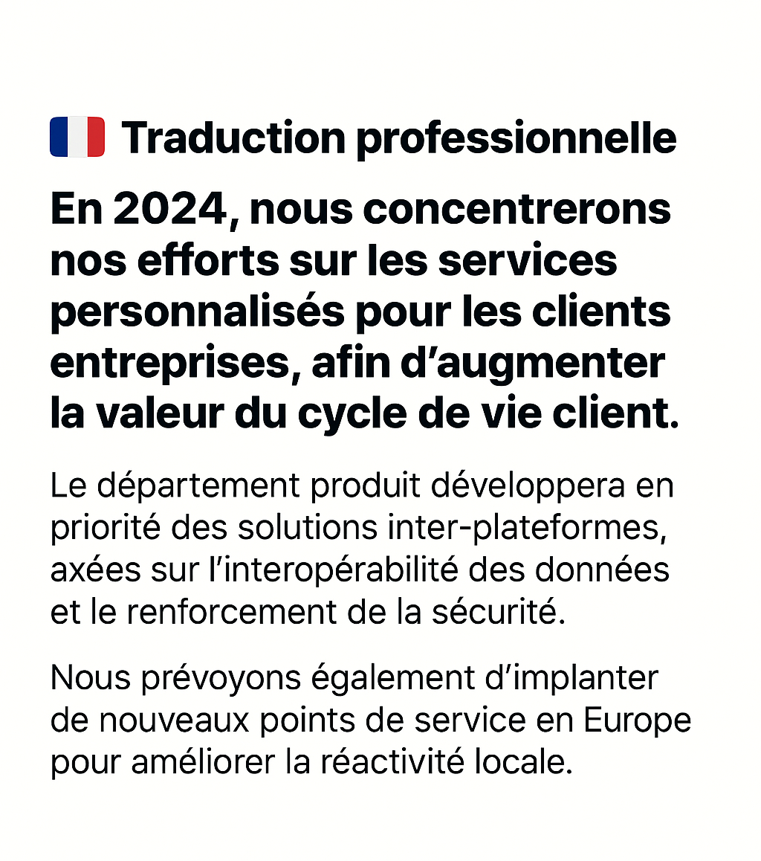

Slide 11
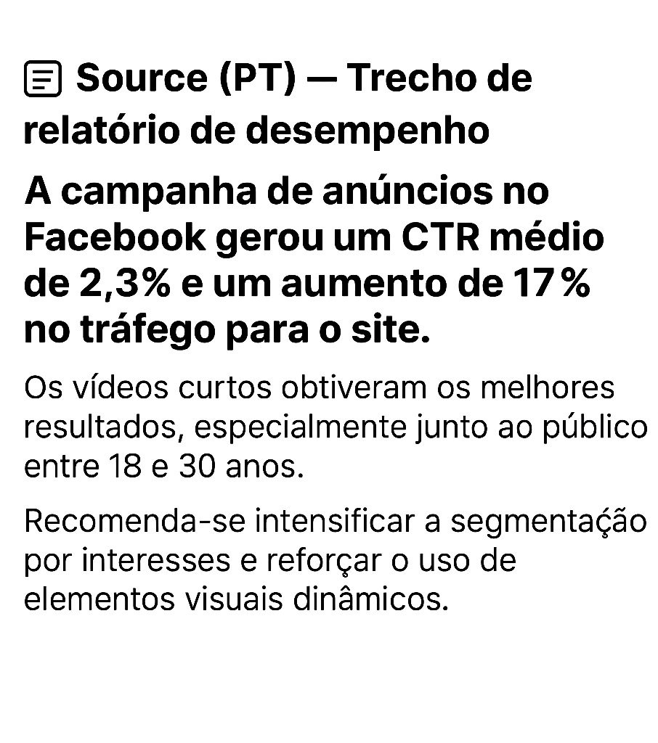
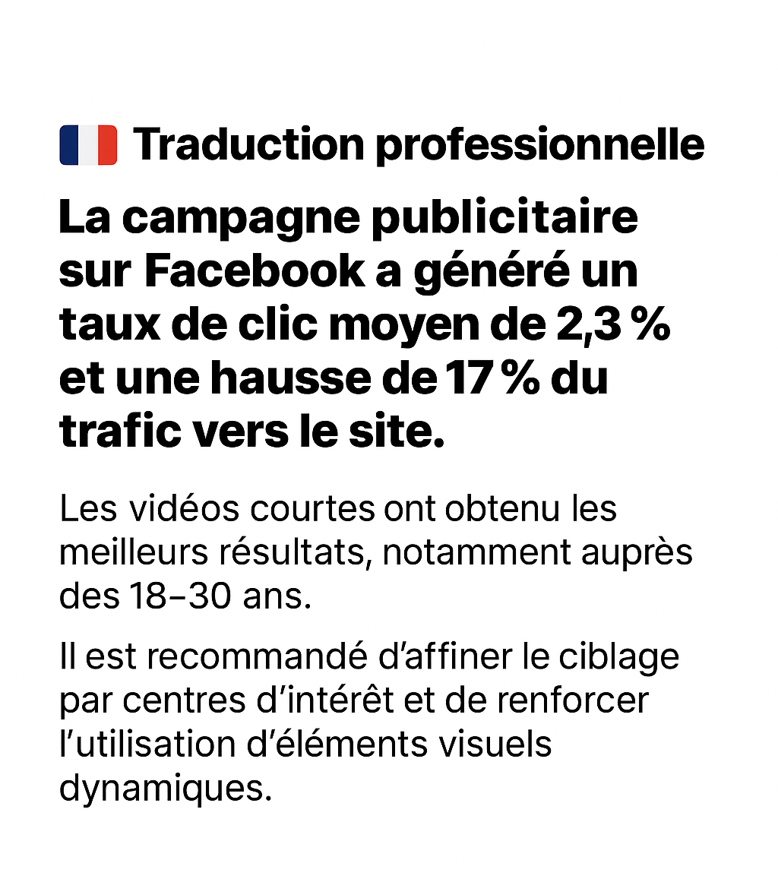

Slide 12
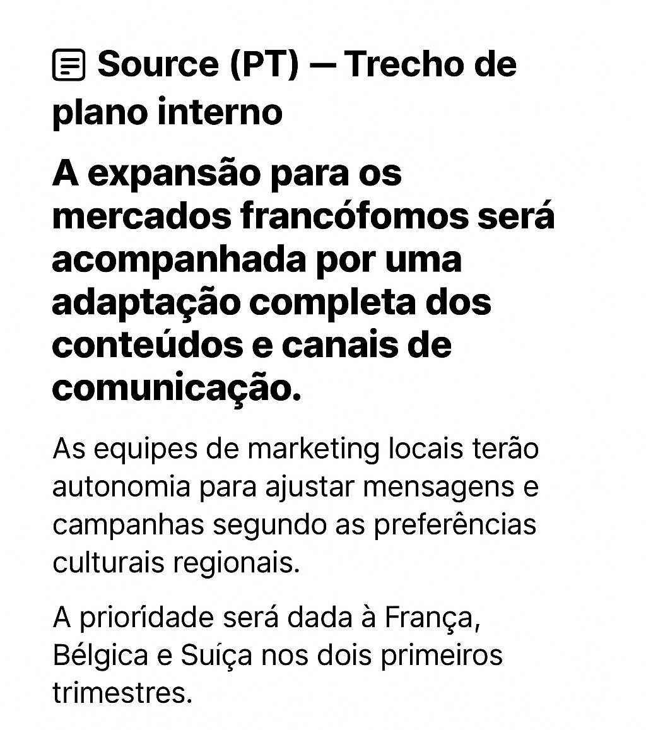
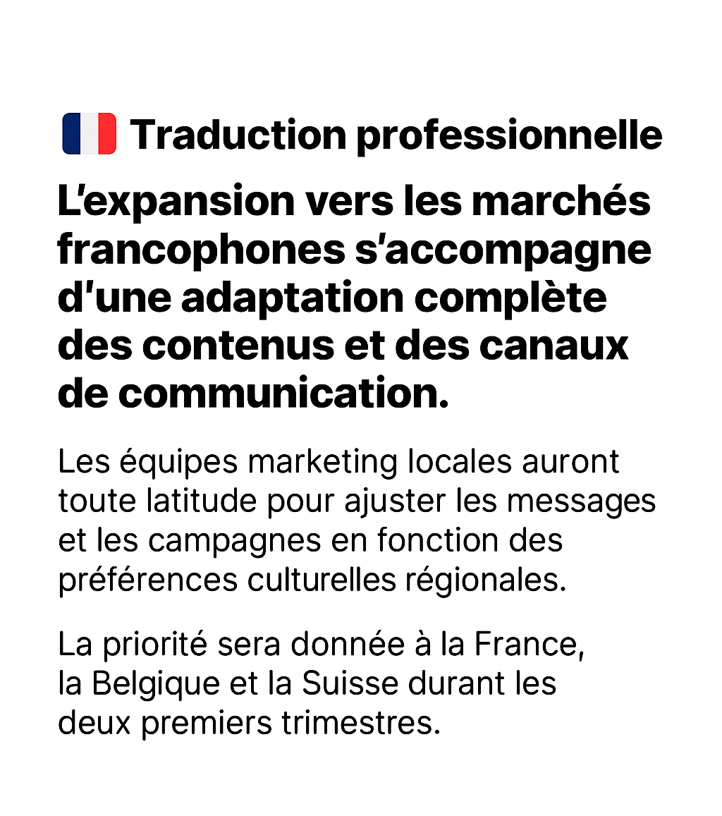

Slide 13
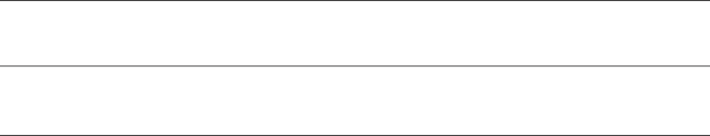
Phone Number
+262 6 93 45 05 02
Email
bltransmark@gmail.com
WORK WITH ME!

